Slide 1

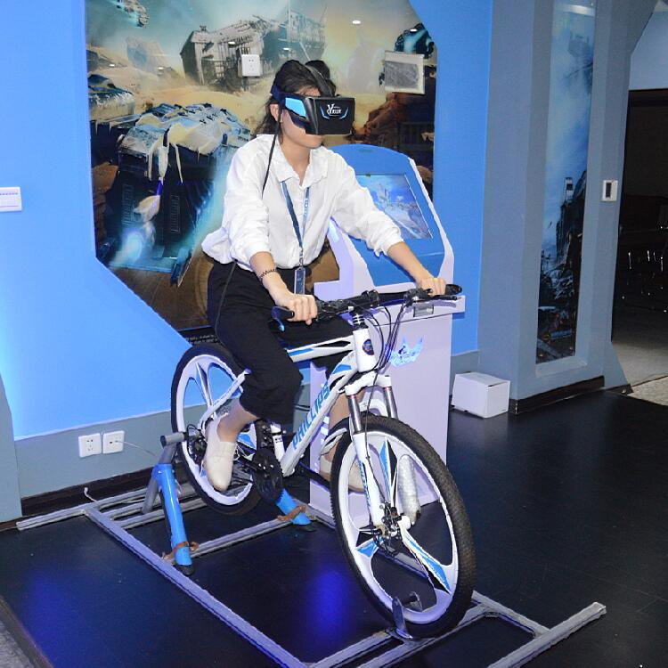
Competitive Virtual Cycling Over 5G
Group members:
180639P - T.A.D.S. Thennakoon
180236D - H.A.D.G. Hettiarachchi
180288L - D.S.B.C.L. Jayaweera
180316A - U.W.R.A.L. Karunathilaka
Supervisor – Prof. Dileeka Dias
Co-supervisor – Dr. Kasun Hemachandra

Slide 2
Project Scope
The relative position between competitors is calculated based on the outputs of the gyroscope
5G technology is used to achieve low latency and high bandwidth requirements
Based on sensor outputs of the user, avatar is placed to indicate the position of the second user.
Web dashboard to show user’s competition statistics and health details

Slide 3
Features
Safer and more comfortable environment
High-intensity interval training
Competitive cycling experience at different geographical locations
Immersive experience
Visualization of the user’s competition statistics and health details

Slide 4
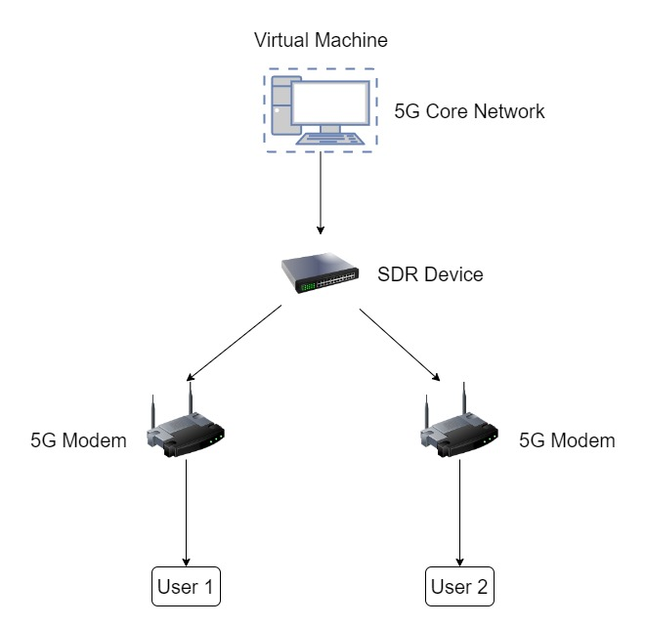
System Architecture 1

Slide 5
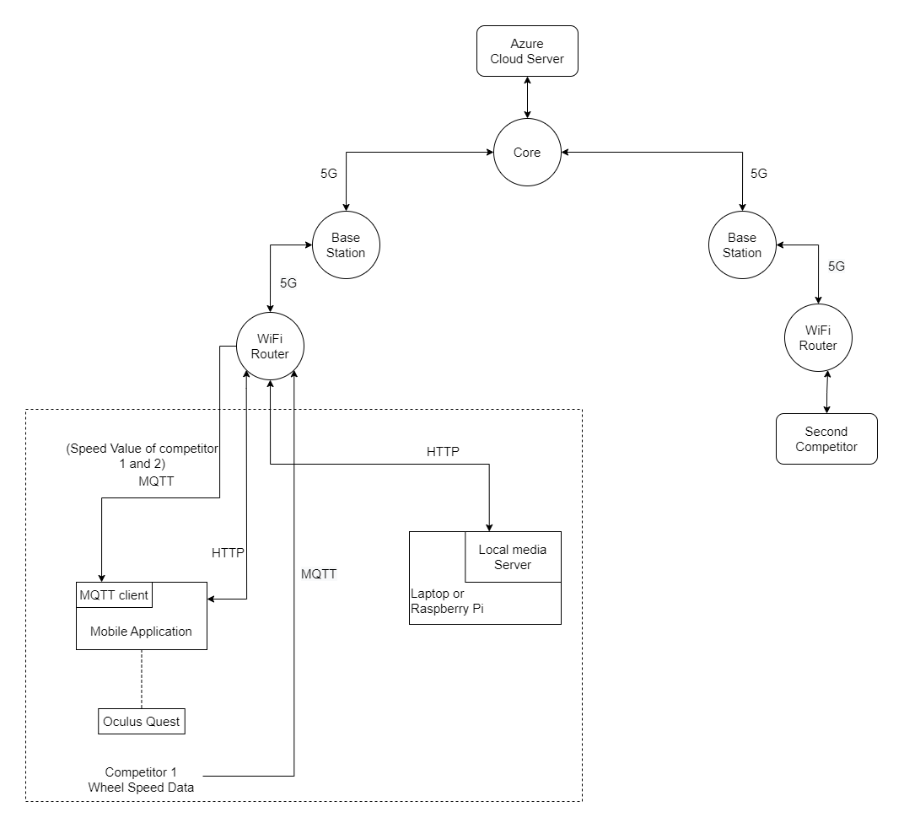
System Architecture 2

Slide 6
Technologies Used
5G
Dialog 5G network established in the university (5G NSA)
Software-defined radio-based network (5G SA)
Communication protocols that can be used for video streaming
MPEG-DASH
HLS
RTMP
Media Streaming services
Nginx media streaming server
3D object positioning
Unity gaming engine with Vuforia SDK is used for 3D object modeling and positioning

Slide 7
Technologies Used Ctd.
Sensor Data Communication protocols
MQTT
Gaming environment development
Unity gaming engine
User Dashboard development
Firebase Hosting services and databases
Angular

Slide 8
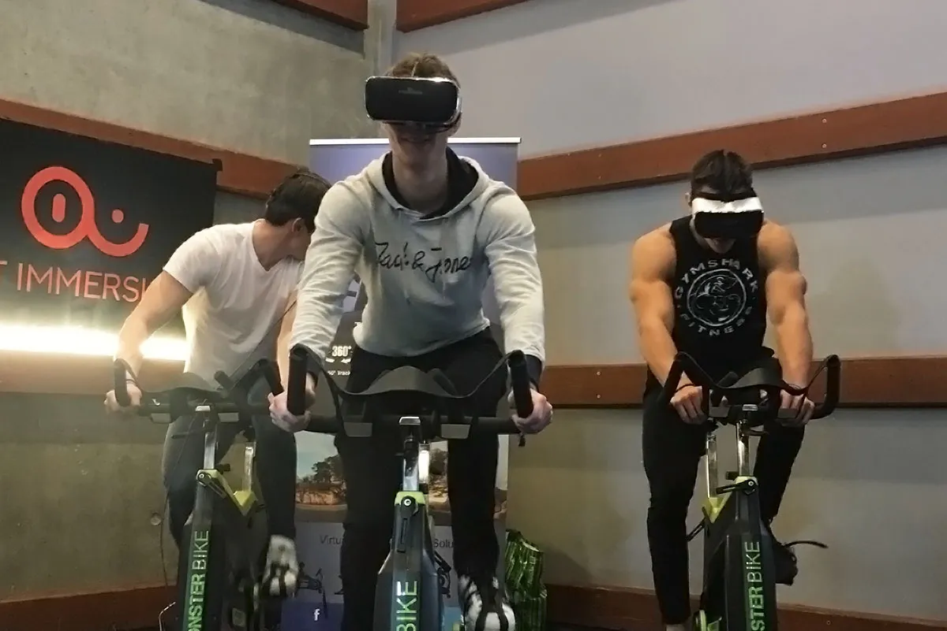
Thank You

